Slide 1
INT8 model code 변환
Sunghyun Lee, Suhak Lee
Department of Computer Engineering
Notes:
https://xilinx.github.io/brevitas/v0.12.0/index.html

Slide 2
Convolution flow
scale1
scale2
CONV 1
CONV1 output
CONV 2 input
CONV 2
M = scale1/scale2
(CONV 1 output * scale1) / scale2 = CONV 1 output * M
= CONV 2 input
dequantize
quantize again
Dequantize the conv1 output by multiplying it by scale 1, and then quantize again it by dividing it by scale 2.

Slide 3
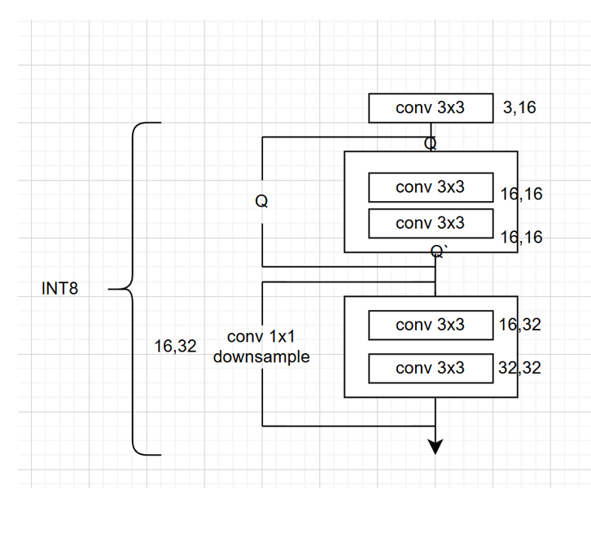
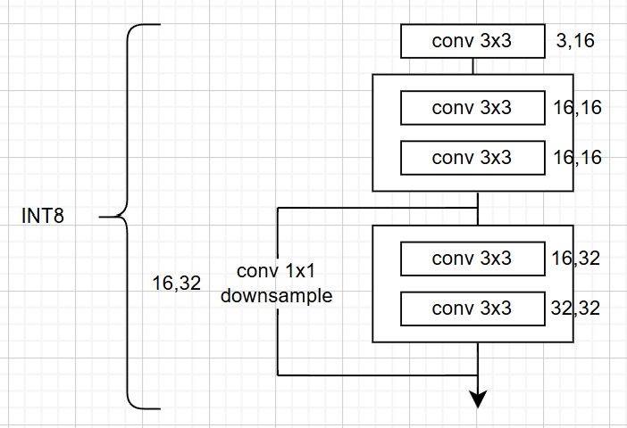
Problem
M3
M4
ADD
M1
M2
ADD
By adding dowsample, We need to consider M

Slide 4
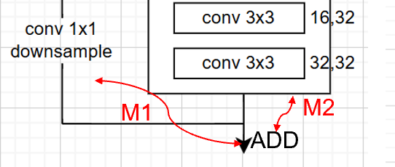
Downsample
conv downsample
main conv
output 1 scale1
output 2 scale2
X M1
X M2
input 1 of Elementwise add (scale3)
input 2 of Elementwise add (scale3)
Elementwise add : input1 + input2

Slide 5
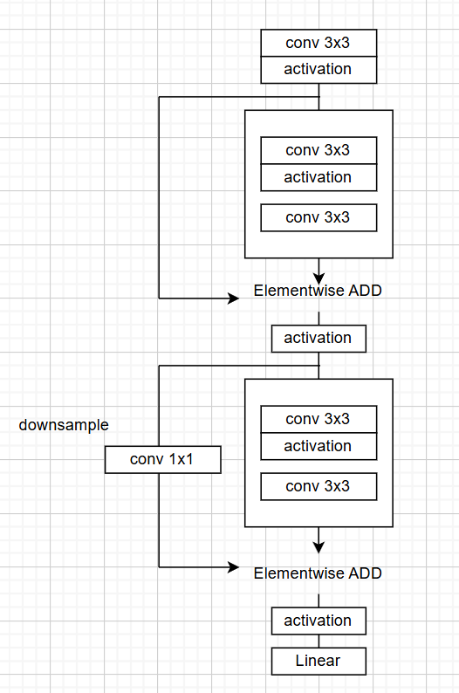
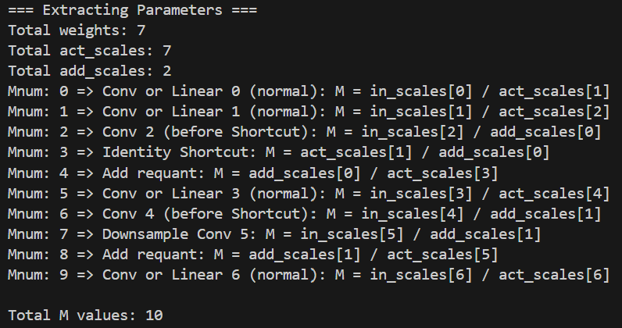
What I did
M0
Revise get_int_params function to extract M
For example:
M1
M3
M2
M4
M5
M7
M6
M8
M9

Slide 6
To do
Revise Shortcut C code to include M
And then revise the generate C code function

